Slide 1
Voxel Cone Tracing based Real-Time Global Illumination
孙硕 夏苏安 夏文夫

Slide 2
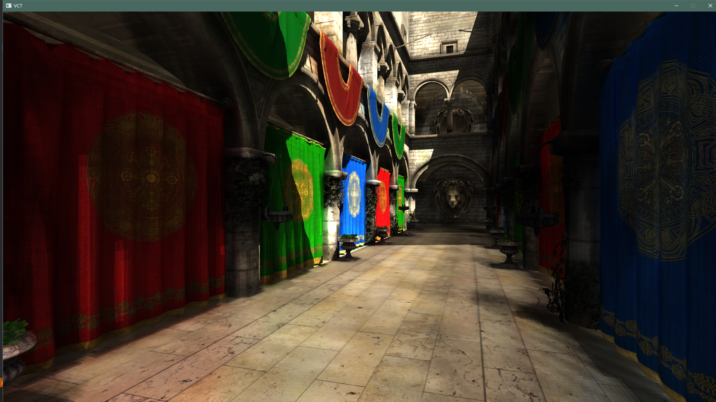

Slide 3
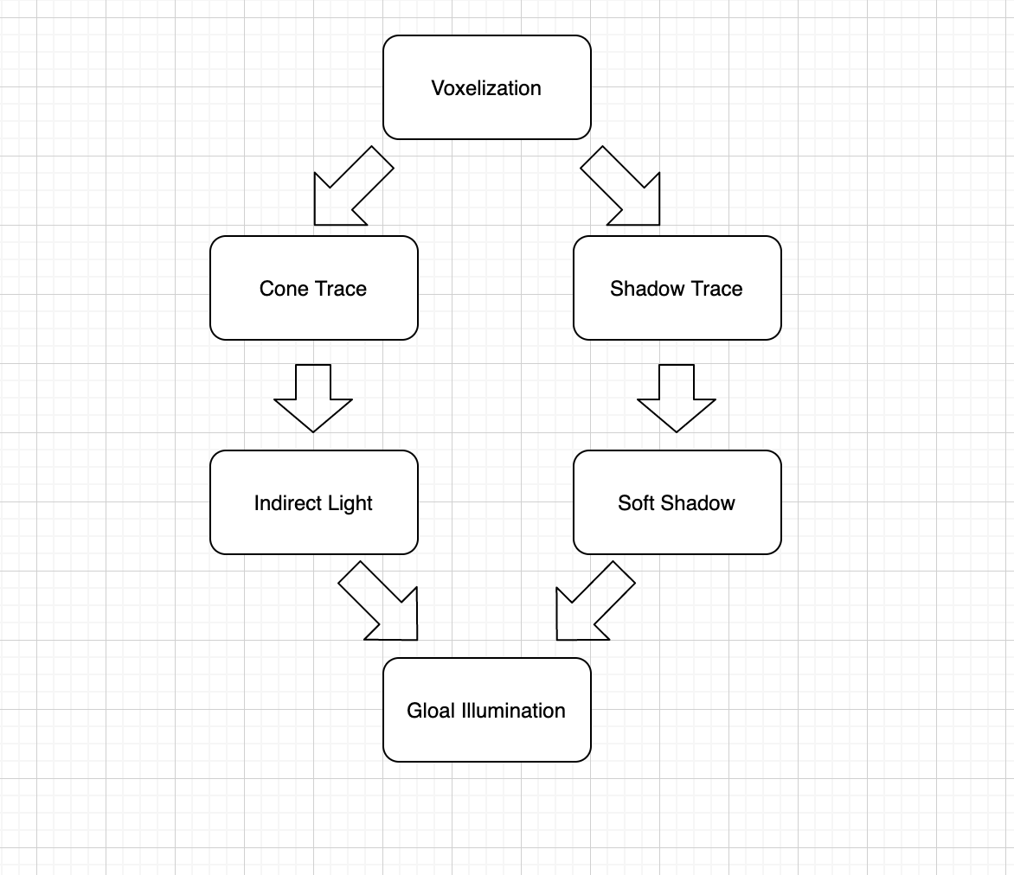
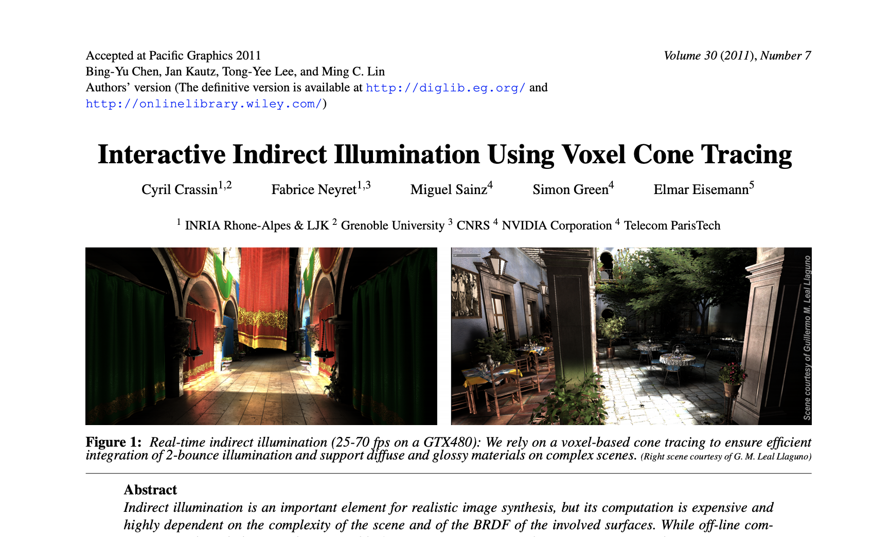
Overview

Slide 4
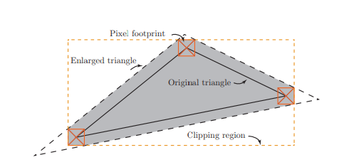
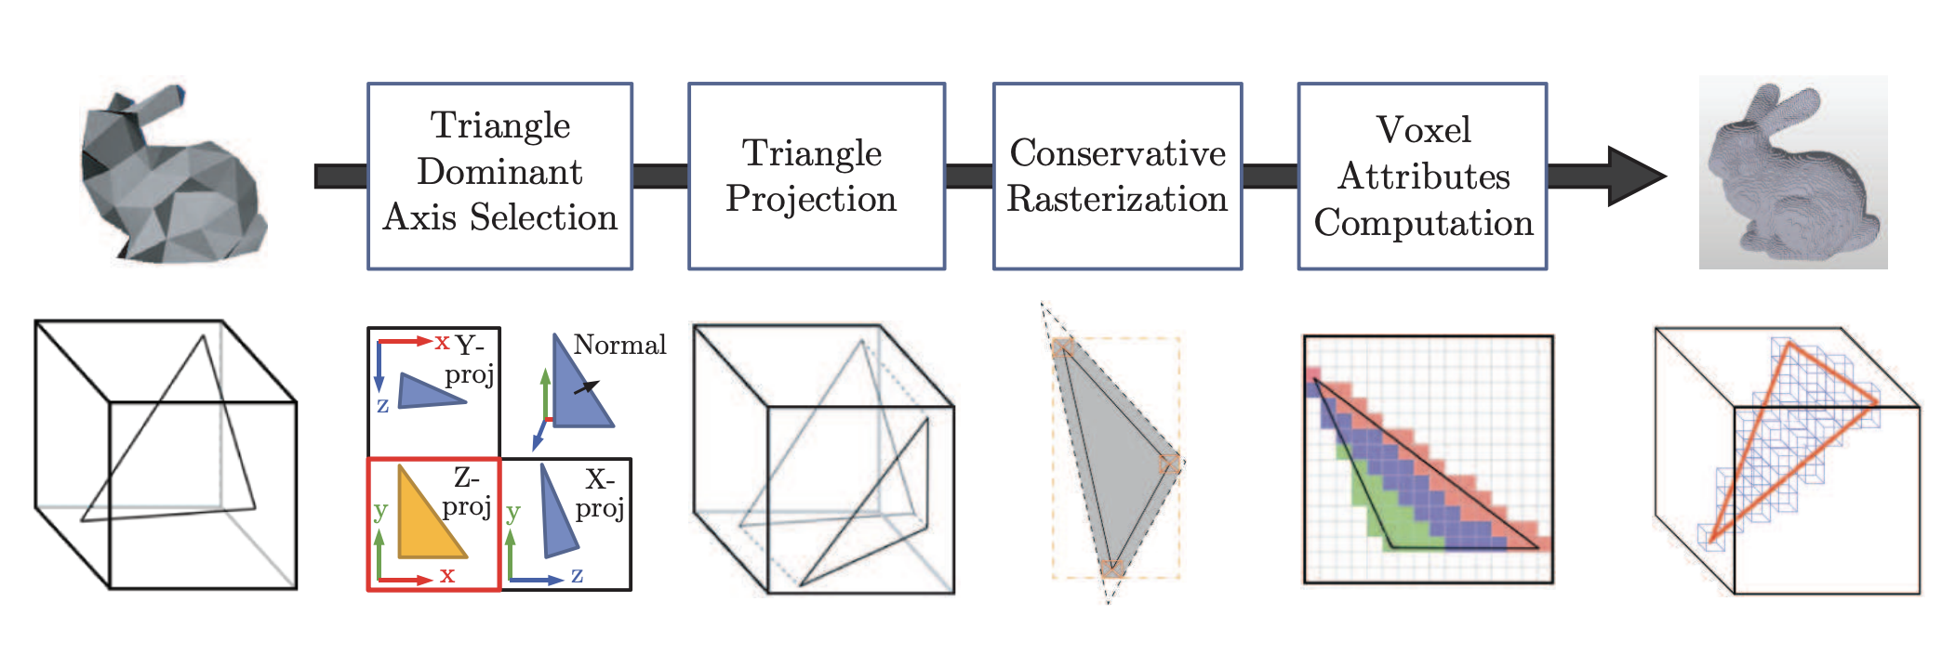
Voxelization
Geometry shader
Fragment shader
Store in 3D Texture

Slide 5
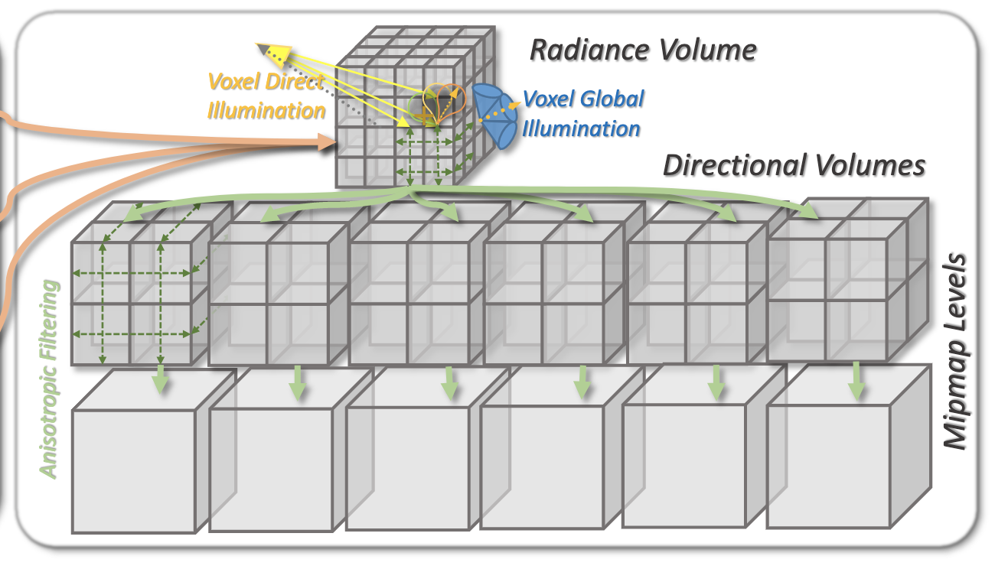
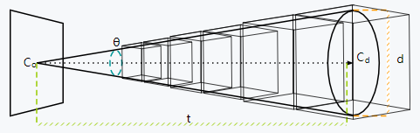
cone tracing
Use previous color information stored 3D Texture in voxelization shaders
In rendering shader:
Use front-to-back accumulation (hw5)
d: diameter of cone enlarged every step
Use textureLod(texture, coord, lod_level)
lod_level = log2(t/voxel Size)
3D Texture & Mipmap
Cone Trace Approximation

Slide 6
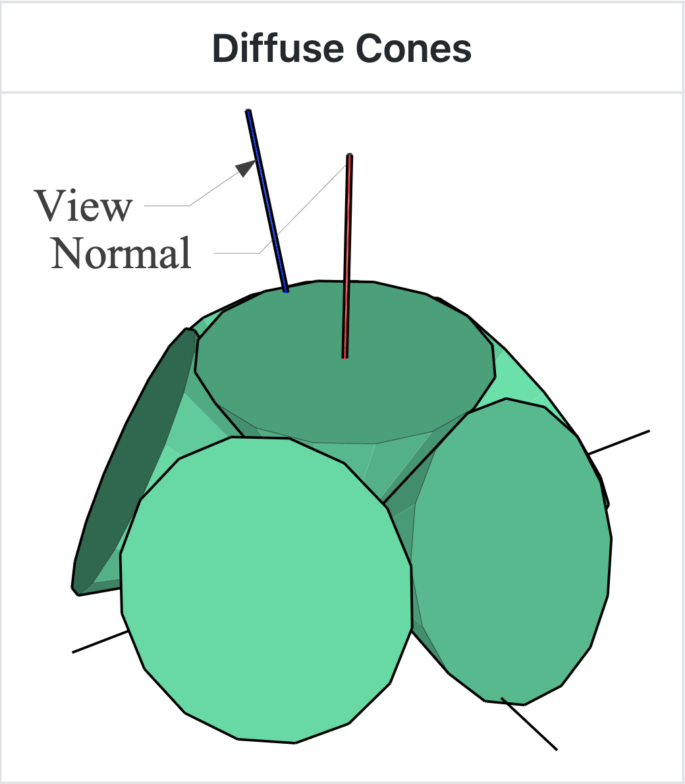
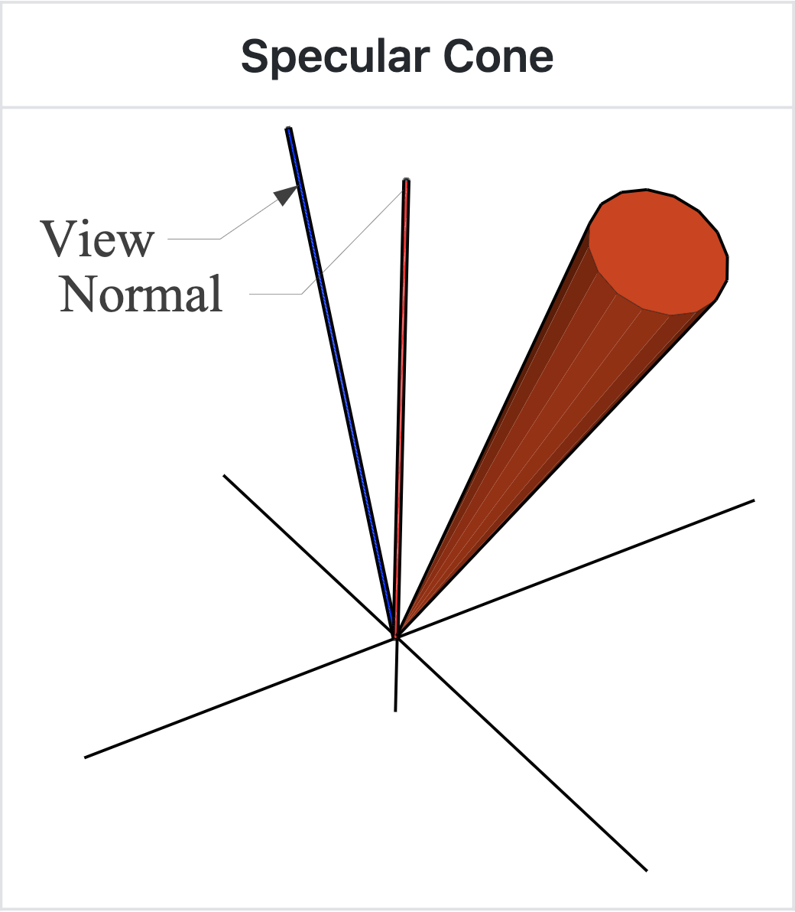
Global Illumination
Aim to get a color for this fragment
In rendering shader:
Direct diffuse lighting by Phong model for each fragment
Indirect diffuse by use six cones in normal direction to approximate BRDF hemisphere by cone trace.
Indirect specular by use one cone in reflect light direction by cone trace.
Indirect Lighting

Slide 7
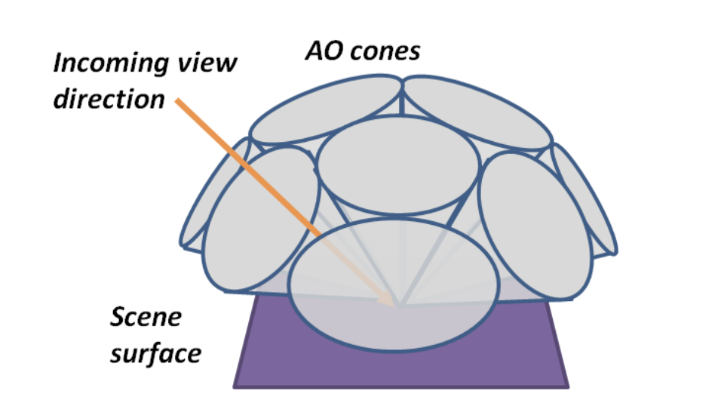
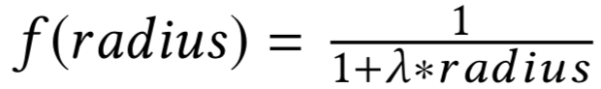
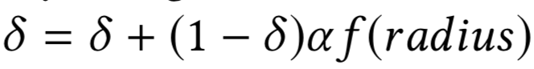
Ambient occlusion
Same ideal as tracing light
Aim to get an occlusion value 𝛅 for this fragment
For every fragment:
Use six cones above hemisphere
Instead of accumulating color, accumulate occlusion value 𝛼 by
AO Tracing

Slide 8
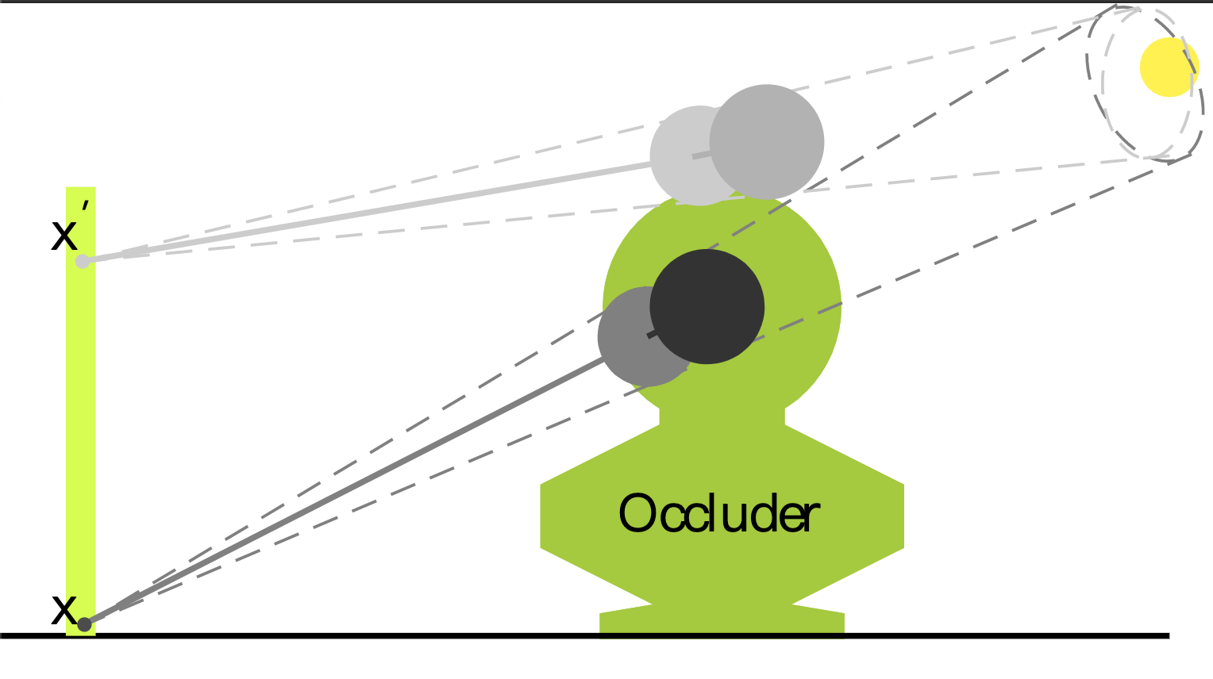
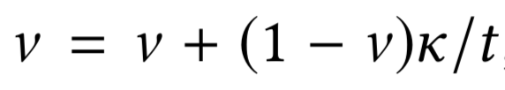
Soft shadow
Same ideal as tracing light
Aim to get visibility 1-v
For every fragment:
cone(line) trace towards light
Accumulate k term

Slide 9
DEMO

Slide 10
Thanks

